Slide 1

Green Pace
Security Policy Presentation
Developer: Breanna Hodges

Slide 2

OVERVIEW: DEFENSE IN DEPTH
Practice Defense-in-Depth during development
Aids in protecting software with multiple layers of security
Stops attacks quickly
Helps find and fix vulnerabilities

Slide 3
THREATS MATRIX
Security standards have levels that evaluate the likelihood and priority of potential security threats.
Likely Threat has a high chance of occurring. | Priority Standard should get implemented soon.
Low priority Standard should get implemented eventually. | Unlikely Threat is less likely to occur.

Slide 4
10 PRINCIPLES
Validate Input Data
Heed Compiler Warnings
Architect and Design for Security Principles
Keep It Simple
Default Deny
Adhere to the Principle of Least Privilege
Sanitize Data Sent to Other Systems
Practice Defense in Depth
Use Effective Quality Assurance Techniques
Adopt a Secure Coding Standard

Slide 5
CODING STANDARDS
Ensure operations on signed integers do not result in overflow. (STD-001-CPP)
Use valid ranging of integer data types to prevent integer overflow between signed and unsigned integer conversions. (STD-002-CPP)
Buffer boundaries not set and incorrect string sizes can lead to runtime errors and buffer overflows. (STD-003-CPP)
Already owned pointer values should not be stored in an unrelated smart pointer. (STD-004-CPP)
Do not read uninitialized memory. (STD-005-CPP)
Functions that return a value must return a value from all exits. (STD-008-CPP)
All code needs to be commented in order to tell the next person what you are doing. Use comments consistently and in a readable fashion. (STD-009-CPP)
Handle exceptions thrown before main() begins. (STD-007-CPP)
Do not delete polymorphic object without virtual destructor. (STD-010-CPP)
Use assert statements to handle errors that test for conditions that should never be true. (STD-006-CPP)

Slide 6
ENCRYPTION POLICIES
Encryption in rest
Used to help protect data that is stored on a disk
Encryption at flight
Encryption of data that moves over a network
Encryption in use
Ensures sensitive data is never left unsecured
Can be any lifecycle stage or location

Slide 7
TRIPLE-A POLICIES
Authentication
The process of identifying a user through valid credentials (username, password, phone number, keys, and biometrics)
Ensures data is kept secure by allowing users access to only information they are authorized to access
Authorization
The right to access data based on the user’s role and privileges
Adhere to the principle of least privilege
Accounting
The process of keeping track of a user’s activity while accessing the network resources
Including the amount of time the user spends in the network, files accessed while there, and amount of data transferred during the session

Slide 8
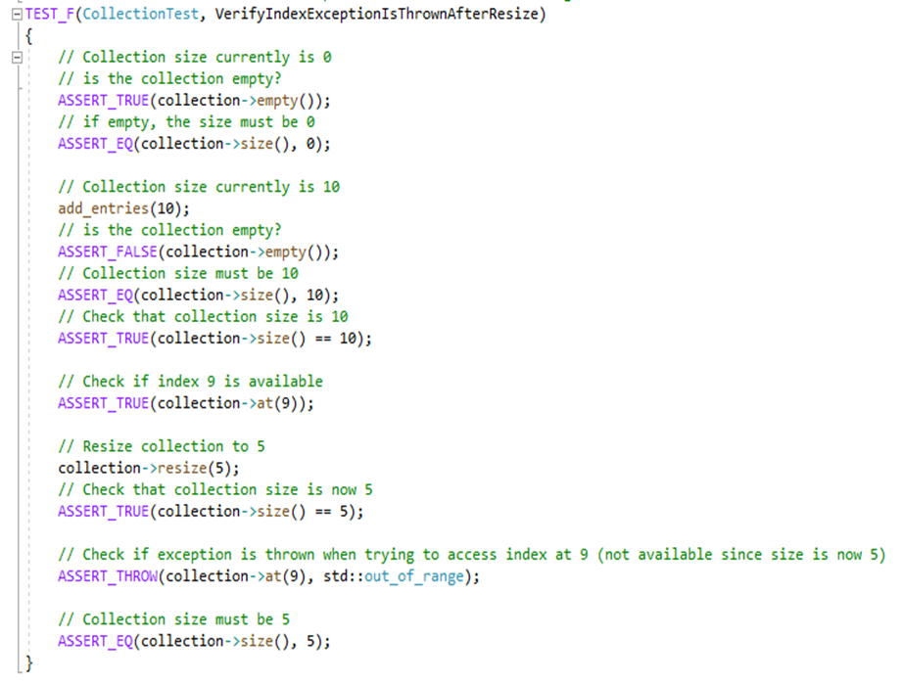
Verify Index Exception is Thrown After Resize

Slide 9
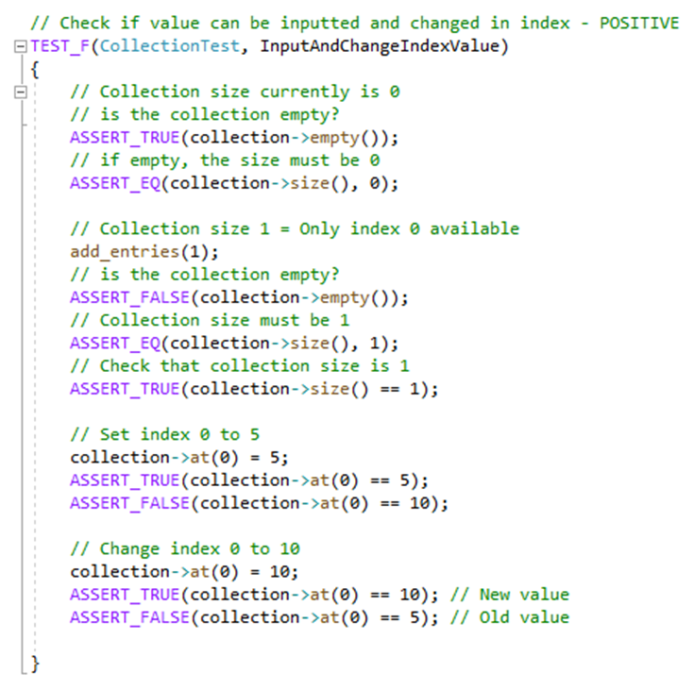
Can Value Be Input and Changed in Index

Slide 10
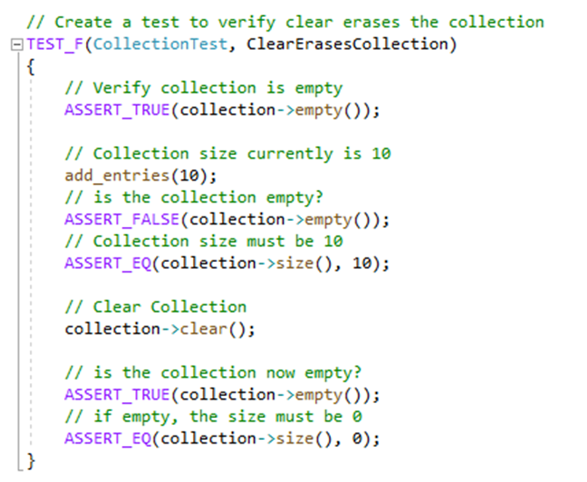
Clear Erases Collection

Slide 11
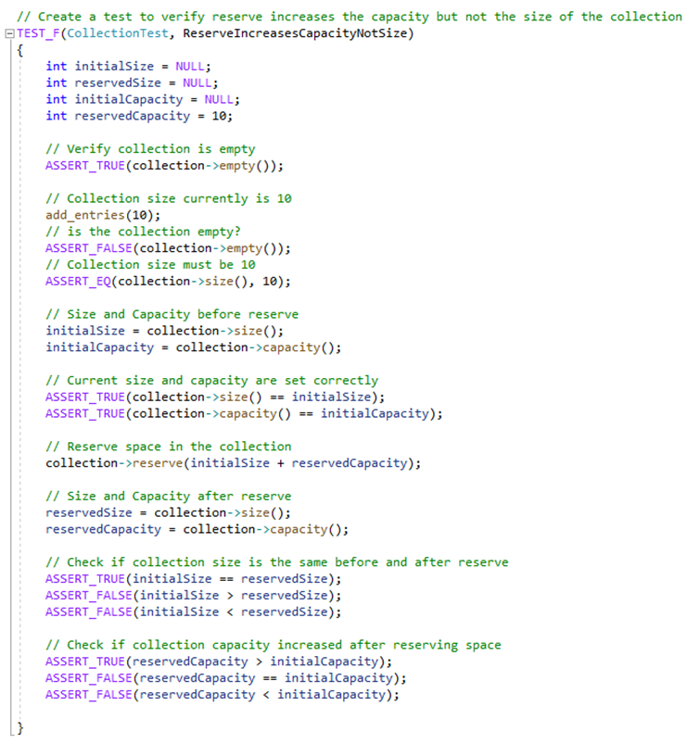
Reserve Increases Capacity Not Size

Slide 12

AUTOMATION SUMMARY

Slide 13
TOOLS
Security-Focused Software Development Life Cycle
Plan/Design
Planning Tools
Build
Compiler
Coding Standards
Testing
Unit Testing
Static Code Analyzer
Dynamic Application Security Tests
Deployment
Configuration Management
Runtime Verification Tools

Slide 14
RISKS AND BENEFITS
Act NOW
May save money
Keep trust of clients
Secure information quickly
Mitigates current threats
High upfront cost
May not have all resources available
Act LATER
Attacks may happen
Lose trust of clients if data breach occurs
May be more expensive in the long run
Allows more time to retrieve resources

Slide 15
RECOMMENDATIONS
Reference all CERT Coding Standards
Implement Encryption and Triple-A policies as soon as possible
Security training
Implement Defense-In-Depth
Revise and edit security policies regularly

Slide 16
CONCLUSIONS
Follow 10 Core Security Principles
Implement Encryption and Triple-A policies
Acting NOW is best
Always reference CERT coding standards

Slide 17
REFERENCES
[Carnegie Mellon University Software Engineering Institute. SEI External Wiki Home - Homepage - Confluence (cmu.edu). Provides information about security policies for programming systems and languages.
Das, P. (n.d.). In-Use Encryption – What it is and How Companies Benefit. Soterosoft. Retrieved from Data in Use Encryption | What It Is and How Companies Benefit (soterosoft.com)
SEI CERT C Coding Standard: Rules for Developing Safe, Reliable, and Secure Systems. (2016). Carnegie Mellon University Software Engineering Institute. Retrieved from SEI CERT C Coding Standard: Rules for Developing Safe, Reliable, and Secure Systems (2016 Edition) (cmu.edu)
Zettler, K. (n.d.). DevSecOps Tools. Atlassian. Retrieved from DevSecOps Tools | Atlassian

